Slide 1



Quality management systems (ISO 9001:2015)
Evangelia Daratsanou
Agricultural University of Athens
edaratsanou@gmail.com
Kalliopi Vassilaki
QMS Consultant
pvasilaki@hotmail.com

Slide 2
Outline
Quality Management Systems (ISO 9001:2015)
Introduction
1. Definition
2. Structure & Requirements of Standard ISO 9001:2015

Slide 3
Learning outcomes
The trainee/student will be able to:
understand the basic purpose of quality management systems, as for ISO 9000
understand the seven quality management principles and their correlation to organizational context and performance improvement
adopt a threats and opportunities approach to quality management
aquire a first introduction to the Structure & Requirements of the ISO 9001:2015 Standard

Slide 4
1. Quality management systems (ISO 9001:2015)
Quality management (QM) is the use of management techniques and tools to achieve consistent quality of products and services.
A QMS is a tool to help any organization to manage quality, in order to retain consistent quality of products and/or services, for achieving maximum customer satisfaction at the lowest overall cost to the organization while continuing to improve the process.
One thing a QMS is not is just the quality manual! (It is not even obligatory any more…) The quality manual is a means of recording how quality is managed within an organisation so everyone does their job in a consistent way, delivering a consistent and quality product or service. In other words, a quality manual reflects the business and the quality management system.

Slide 5
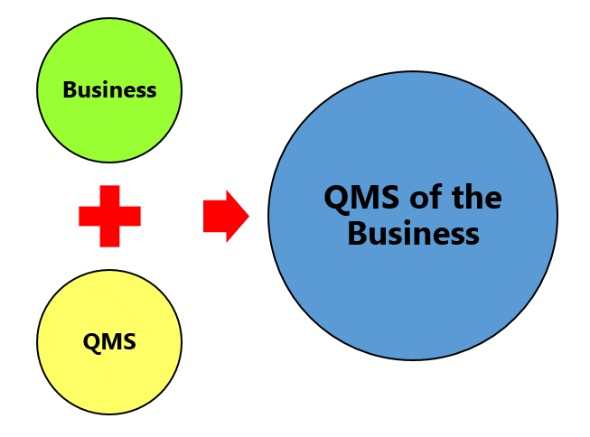
1. Quality management systems (ISO 9001:2015)

Slide 6
1. Quality management systems (ISO 9001:2015)
Plan – Do – Check – Act cycle
The clauses and requirements of the standard are all based on the Plan – Do – Check – Act (PDCA) cycle. PDCA is integral and operates at the process level and at an overall system level.

Slide 7
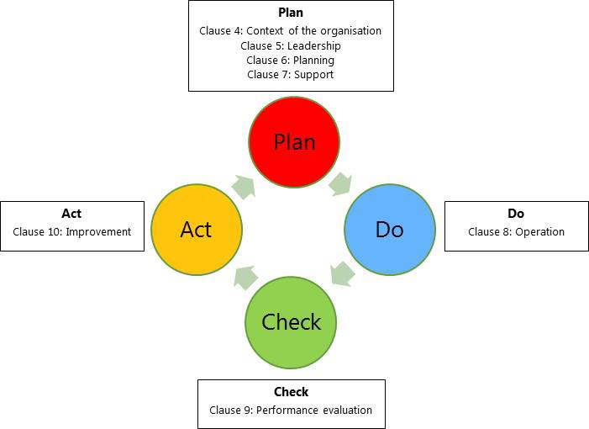
1. Quality management systems (ISO 9001:2015)

Slide 8
References
Quality management systems — INTERNATIONAL
STANDARD ISO/FDIS 9001 Requirements, ISO/TC 176/SC 2, 2015, Final Draft
Quality management principles - ISO.Org, 2012
ISO. The ISO Survey of Management System Standard Certifications – 2015, Geneva: ISO 2015
ISO 9001:2015, “HOW TO USE IT”, iso.org, 2015
ISO 9001:2015 Explained: The Process Approach - Blog - Qualsys quality.eqms.co.uk/blog/what-is-a-process-approach
Continuous Quality Improvement with PDCA (Source: Johannes Vietze, 2013

Slide 9
1. Quality management systems (ISO 9001:2015)
1. Introduction - Definitions

Slide 10
1. Introduction - Definitions
About Quality Management
  Quality Management: The total of scheduled or systematic actions or procedures which are necessary to ensure that a product or service meets certain specifications.
Certification
  The official recognition that an organisation has the ability to meet its customers requirements, the relevant to the product / service legal and regulatory requirements as well as its own internal requirements.
  It is implemented in all organisations dealing with design, production, installation and support of products or/and services.

Slide 11
1. Introduction - Definitions
Quality
  The degree to which a total of inherent characteristics meets requirements
Quality Management System (QMS)
  The management system for the directions and control of an organisation in terms of quality
Process
  The total of interconnected and interacting activities transforming incomings into outgoings
Requirements, incl. Labour Law
Resources, incl. Human
Goals
Controls
Process
interconnected and interacting activities
Products Services Information
Results
Products Services Information
Data

Slide 12
1. Introduction - Definitions
Procedure
  A defined way of executing a n activity or process
Compliance
  Meeting a requirement
Non - compliance
  Not Meeting a requirement
  Organizational context
  Defined through processes. Processes examine internal factors (culture, knowledge, values, performance) and external factors (social, legal, economic, technological, cultural) and how these affect the organisation’s purpose, goals and viability.
Risk:
  The influence of uncertainty (positive or negative).

Slide 13
1. Introduction - Definitions
Documented Information
  Information the organisation must control and update in writing.
Quality Policy
  The total of goals and directions of an organisation regarding quality, as they are officially established by Senior Management. Quality Policy is an element of the organisation’s overall policy and is approved by Senior Management.
Interested Parties
  Can pose significant risk in terms of the organisation’s viability if their needs and expectations are not met.
  Awareness
  Staff have full awareness and understanding of their responsibilities and the ways in which they can contribute to the achievement of the organisation’s goals.

Slide 14
Self-evaluation questions
What is a Quality Management System (QMS)?
  (answer): QMS is the management system for the directions and control of an organisation in terms of quality
A Quality Management System is suitable mainly for industrial organisations. Do you agree with that statement?
A. Correct B. Wrong
(correct answer: B)
Within a QMS, we use processes in order to define the Context of the Organization in terms of:
A. internal factors (culture, knowledge, values, performance)
B. external factors (social, legal, economic, technological, cultural)
C. General Manager’s personal views and attitudes
D. A+B
E. all the above
(correct answer: D)

Slide 15
Structure & Requirements of Standard ISO 9001:2015 (A short overview in correlation to the 7 Management Principles)

Slide 16
2. Structure & Requirements of Standard ISO 9001:2015
  THE STANDARD’S STRUCTURE – THE 7 FUNDAMENTAL PRINCIPLES OF QUALITY MANAGEMENT
According to the ISO, ISO 9000, ISO ­9001 and related ISO quality management standards are based on seven Quality Management Principles (QMPs). The achievement of those QMPs, is essential for the efficient and successful management of any organization worldwide.
The revised version of ISO 9001:2015 Standard, is based on the following Seven principles of Quality management:
QMP 1 – Customer focus
QMP 2 – Leadership
QMP 3 – Engagement of people
QMP 4 – Process approach
QMP 5 – Improvement
QMP 6 – Evidence-based decision making
QMP 7– Relationship management

Slide 17

2. Structure & Requirements of Standard ISO 9001:2015
  THE STANDARD’S STRUCTURE – THE 7 FUNDAMENTAL PRINCIPLES OF QUALITY MANAGEMENT
  Customer focus: The satisfaction of the customer’s requirements and needs with a continuous effort to over- satisfy their requirements and needs.
  Leadership: Gives direction for unity and engagement of staff with the realisation of quality targets.
  Engagement of people: Places value on the personal contribution of staff in the achievement of goals and results.
  Process approach: The total of interrelated processes for the management of the organisation’s activities.

Slide 18
2. Structure & Requirements of Standard ISO 9001:2015
  THE STANDARD’S STRUCTURE – THE 7 FUNDAMENTAL PRINCIPLES OF QUALITY MANAGEMENT
  5. Improvement: Organizational Improvement is a dynamic and continuous process, that involves everyone within the organization from top management, to managers, and employees. It is a prerequisite for any company or organization in order to operate as effectively as possible.
  6 . Evidence-based decision making: Effective decisions are based on the analysis of data and information. The organization should base their decisions on process performance data generated by the management system, includes audit data, customer complaints and nonconformity data as inputs to decision making.
  7. Relationship management: Sustained success is more likely to be achieved when the organization manages relationships with all of its interested parties to optimize their impact on its performance. Relationship management with its supplier and partner networks is of particular importance

Slide 19
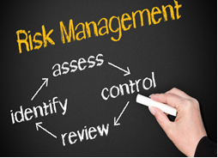
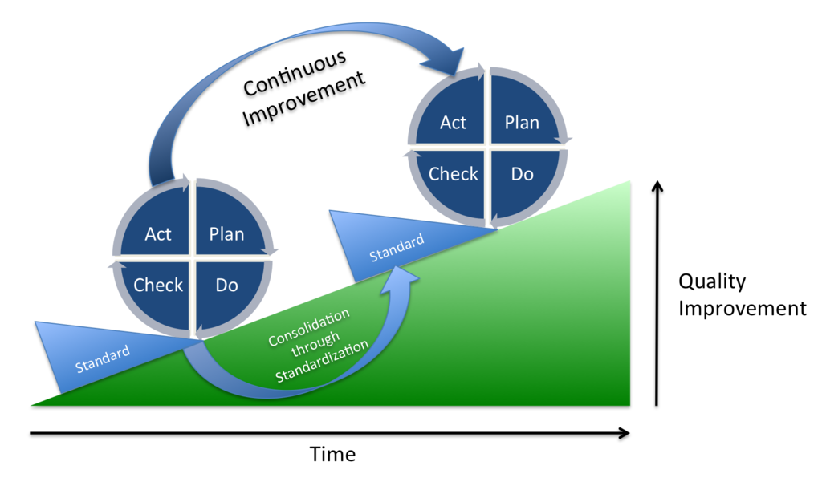
2. Structure & Requirements of Standard ISO 9001:2015
  INTEGRATION OF THE IMPROVEMENT CYCLE & RISK THROUGH THE PROCESS APPROACH
Improvement cycle Plan-Do-Check-Act
Plan: Set the targets of the system and its processes
Do: Implement the plans
Check: Monitor and measure the processes (where applicable)
Act: Take action on performance improvement
Risk implementation

Slide 20
2. Structure & Requirements of Standard ISO 9001:2015
CONTENTS TABLE OF STANDARD EN ISO 9001:2015 – CORELLATION WITH THE PCDA CYCLE

Slide 21
2. Structure & Requirements of Standard ISO 9001:2015
  Clause 4: ORGANIZATIONAL CONTEXT
  The Organisation defines and takes into account all external and internal parameters
  Needs and expectations of relevant interested parties
  Definition of the field of the QMS and its processes)
  The QMS implementation field should be documented in writing.
  QMS processes should:
    be defined,
    interact,
    have defined input,
    Have expected output.

Slide 22
2. Structure & Requirements of Standard ISO 9001:2015
  Clause 4: ORGANIZATIONAL CONTEXT
  The Organisation defines and takes into account all external and internal parameters
  Needs and expectations of relevant interested parties
  Definition of the field of the QMS and its processes)
  The QMS implementation field should be documented in writing.
  QMS processes should:
    be defined,
    interact,
    have defined input,
    Have expected output.
The communication of the Quality Policy as documented written information is a requirement, especially its dissemination to all interested parties.

Slide 23

2. Structure & Requirements of Standard ISO 9001:2015
  Clause 5: LEADERSHIP
  Senior Management has the responsibility of committing
  In terms of the QMS
  In terms of the personnel
  In terms of the customer
The communication of the Quality Policy as documented written information is a requirement, especially its dissemination to all interested parties.

Slide 24
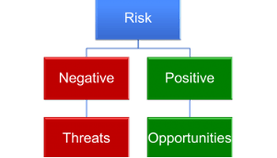
2. Structure & Requirements of Standard ISO 9001:2015
Clause 6: PLANNING
  In the context of risk management, the Organisation should be able to identify the positive results of a risk (opportunities) and the negative results (threats).
  The Organisation should incorporate and implement actions for mitigating threats and exploiting opportunities within the processes of the QMS and evaluate their effectiveness
  Quality Targets – Implementation planning
  Planning of changes to the QMS.

Slide 25
2. Structure & Requirements of Standard ISO 9001:2015
Clause 7: SUPPORT
  The Organisation’s resources comprise of existing internal resources:
    infrastructure,
    staff
    and anything that needs to be sourced from external providers (suppliers.).
  Environment for the implementation of processes
  Monitoring and measurement of resources
  Measurements and the ability to trace them
  Operational knowledge
  Professional adequacy: Staff’s professional adequacy is defined by the Organisation
  Awareness
  Communication

Slide 26
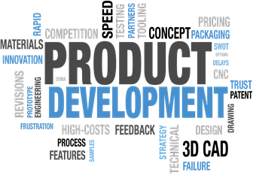
2. Structure & Requirements of Standard ISO 9001:2015
Clause 8: OPERATIONS
  Operations planning and control: At the implementation of processes the Organisation should:
    define the requirements on products and services,
    define the control criteria of its processes and the criteria of approval of its products and services,
    define its resources
    define the auditing of its processes based on the criteria
    keep appropriately evidenced information to the necessary degree
    Monitor the actions of risk management and the Improvement Cycle.

Slide 27
2. Structure & Requirements of Standard ISO 9001:2015
  Communication with the customers.
  Definition of the requirements for products and services. The requirements include:
    Legal and regulatory requirements,
    Requirements defined by the Organisation,
    Requirements defined by the customer.
  Review of the requirements before the release of the product or service.
  Release of the product or service.
  Post-delivery activities (related to warranties and standard obligations)
  Design and development of products and services – Design of suitable processes.
  Planning for the design and development of products and services.

Slide 28
2. Structure & Requirements of Standard ISO 9001:2015
  Design and development control.
  Amendments to the processes for the design and development of products and services.
  Results of the design and development of products and services.
  Production of products and provision of services.
  Audit of production of products and provision of services.
  Identification and tracing.
  Management of non-compliant results. The non-compliant result:
    can be corrected (in this case compliance with requirements must be verified),
    can be separated and secluded,
    Implies informing the customer and authorisation to release the defective product or service,
    can be returned,
    Leads to the cease of the provision of the product or service.

Slide 29

2. Structure & Requirements of Standard ISO 9001:2015
  Audit of products and services provided by external parties
    The Organisation must ensure that processes, services or products provided by external parties (suppliers) do not impact negatively on its ability to offer compliant products and services to its customers.
  Information to external providers
    Within the context of its cooperation with external providers the Organisation should inform them of the requirements governing this cooperation.

Slide 30

2. Structure & Requirements of Standard ISO 9001:2015
Clause 9: PERFORMANCE EVALUATION)
  Monitoring measurement analysis and evaluation.
What should the Organisation do?
It should define:
    What its going to monitor, measure, analyse and evaluate,
    When and with what frequency,
    With which methods..
  Customer satisfaction..
  Analysis and evaluation.
  Internal inspection – It should be conducted at scheduled times in order to evaluate:
    The compliance of the QMS with internal and ISO 9001 2015 requirements,
    The effectiveness of the QMS.

Slide 31
2. Structure & Requirements of Standard ISO 9001:2015
  Review from the Management
  It is planned and executed on the following sectors:
    Effectiveness of actions implemented after previous reviews,
    Changes or improvements to internal and external parameters,
    Customer satisfaction,
    Feedback from interested parties,
    Achievement of quality targets,
    Process performance,
    Compliance of products and services / non-compliance,
    Corrective actions,
    Monitoring and measurement results,
    Internal inspection results,
    Supplier performance,
    Effectiveness of the actions of threat mitigation and opportunity exploitation.

Slide 32
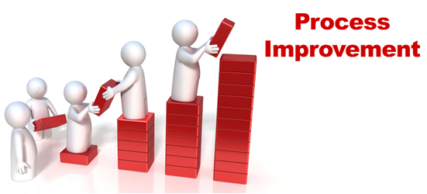
2. Structure & Requirements of Standard ISO 9001:2015
Clause 10: IMPROVEMENT
  The Organisation should implement improvement regarding:
    Meeting product and service requirements,
    Meeting future needs and expectations on products and services,
    Prevention-reduction-elimination of harmful impact on products and services;
    The performance and effectiveness of the QMS.
  Continuous improvement.

Slide 33
2. Structure & Requirements of Standard ISO 9001:2015
Documentation Requirements
  Confirmation of processes and product/services compliance (8.1 ε)
  Results of the review of product/services requirements (8.2.3)
  Confirmation that design and development requirements are met (8.3.2)
  Results of design and development processes (8.3.5)
  Changes in design and development (8.3.6)
  Results of the evaluation, performance monitoring and re-evaluation of suppliers (8.4.1)
  Product and service characteristics (8.5.1 α)

Slide 34
2. Structure & Requirements of Standard ISO 9001:2015
Documentation Requirements
  Activities executed during the production and provision of products and services and the results achieved (8.5.1)
  Documented information required for traceability (8.5.2)
  Results of the review in products and services, the approving staff and any required actions (8.5.6)
  Traceability of people approving the release of products and services for distribution to the customer (8.6)
  Actions taken for non-compliant processes, products ands services (8.7)
  Results of the monitoring and measurement of activities (9.1.1)

Slide 35
2. Structure & Requirements of Standard ISO 9001:2015
Documentation Requirements
  Evidence on the implementation of the programme and inspection results (9.2.2 στ)
  Management review results (9.3.2)
  Nature of non-compliance, actions taken and action results (10.2.2)

Slide 36
Self-evaluation questions
Where is based the revised version of ISO 9001:2015 Standard?
(answer): The revised version of ISO 9001:2015 Standard is based on the seven Quality Management Principles (QMPs)
(2) Which are the seven Quality Management Principles (QMPs)?
(answer): QMP 1 Customer focus, QMP 2 Leadership, QMP 3 Engagement of people, QMP 4 Process approach, QMP 5 Improvement, QMP 6 Evidence-based decision making, QMP 7– Relationship management
The “Plan” phase of the Improvement cycle “Plan-Do-Check-Act”, is linked to which ISO 9001:2015 Clause?
(answer): Clause 4: CONTEXT OF THE ORGANIZATION, Clause 5: LEADERSHIP , Clause 6: Planning , Clause 7: Support

Slide 37



Author(s) information
Evangelia is an Economist, Business Consultant and Quality Manager. Project Manager and Researcher/ Trainer in various National & EU Projects, n terms of entrepreneurship and industrial development. She is an evaluator within The “Competitiveness, Entrepreneurship and Innovation” (EPAnEK) Operational Programme .
Evangelia Daratsanou
Kalliopiis a graduate Chemical Engineer of Patras Institute of Technology. Also has a Master’s degree from the National Technical University of Athens in Economic – Engineer Systems (MBA). she specializes in strategic and business planning issues, in the provision of advisory services to support entrepreneurship, organizational intervention and operational reorganization. She is an expert on Quality Systems for both the public and the private sector.
Kalliopi Vassilaki

